Slide 1
DDL statements
Milind Parab

Slide 2

ALTER Statement.

Slide 3
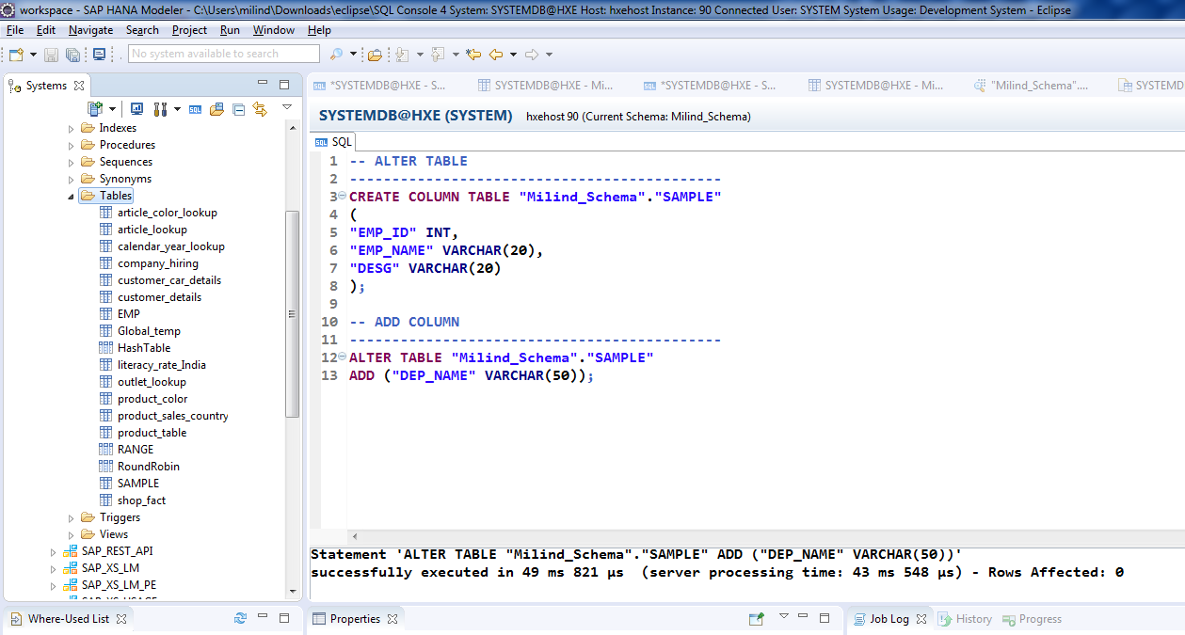
Cont.

Slide 4
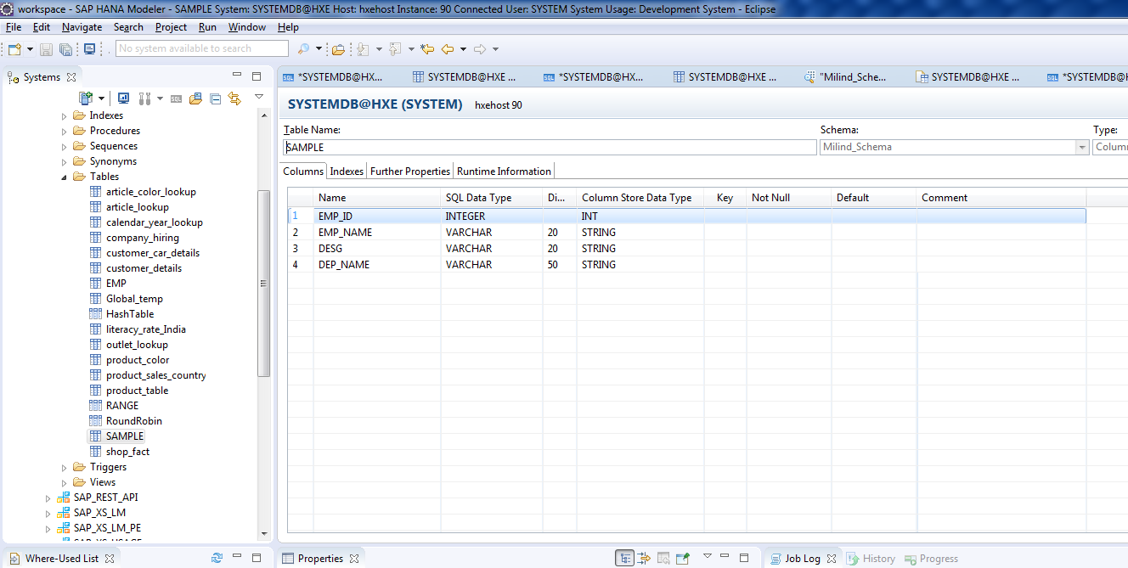
Cont.

Slide 5
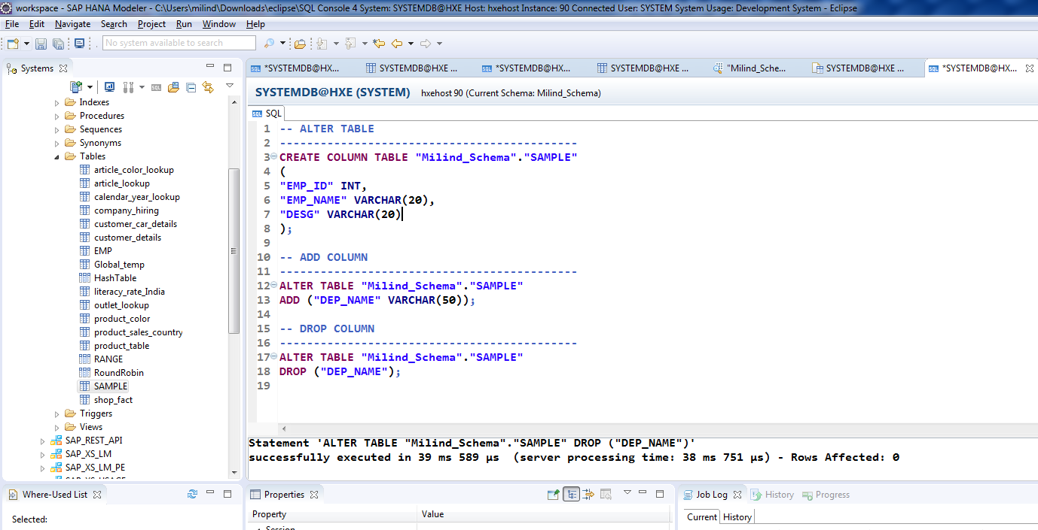
Drop Table

Slide 6
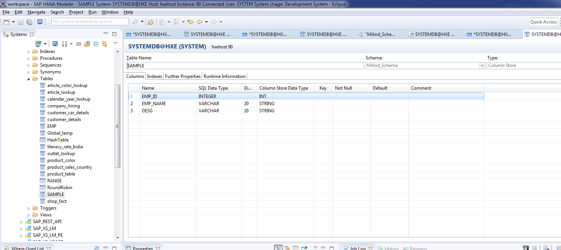
Cont.

Slide 7
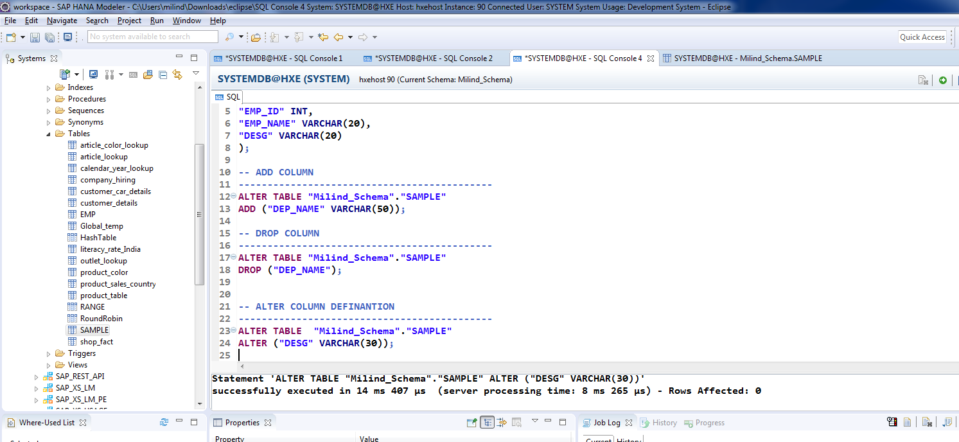
Alter Column Definition.

Slide 8
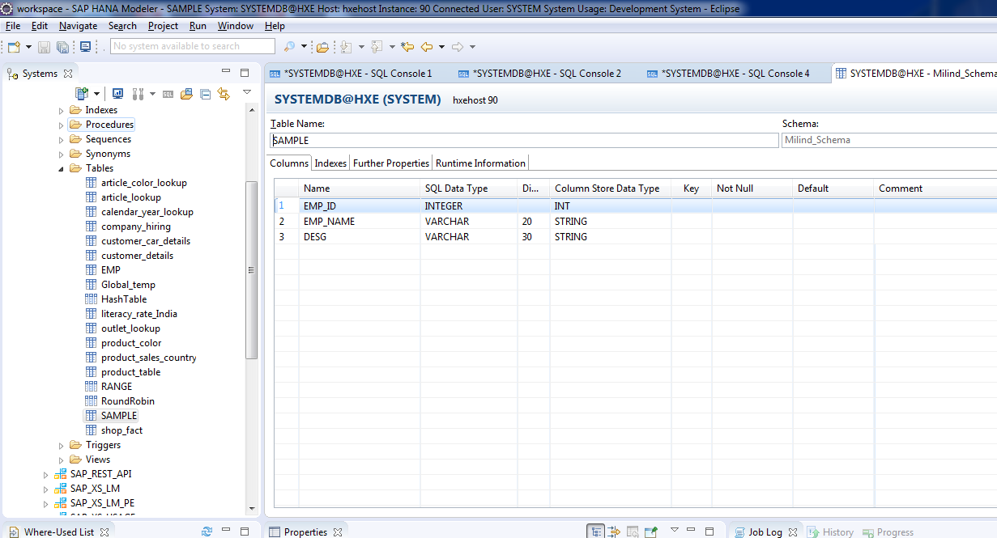
Cont.

Slide 9
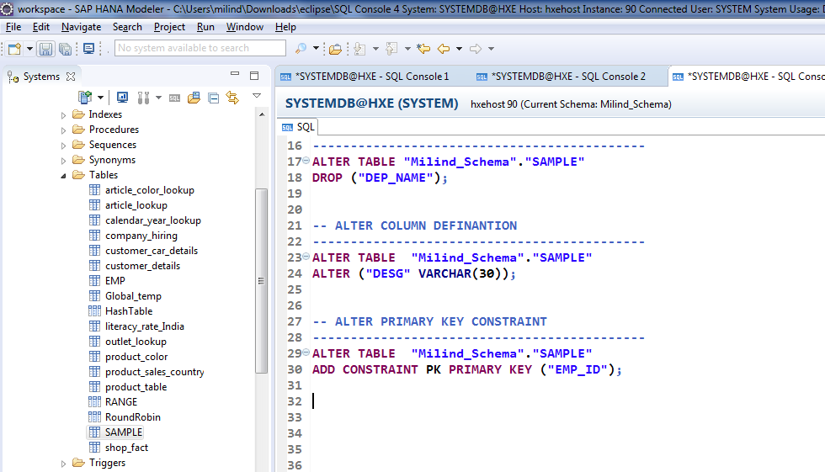
Add Constraint.

Slide 10
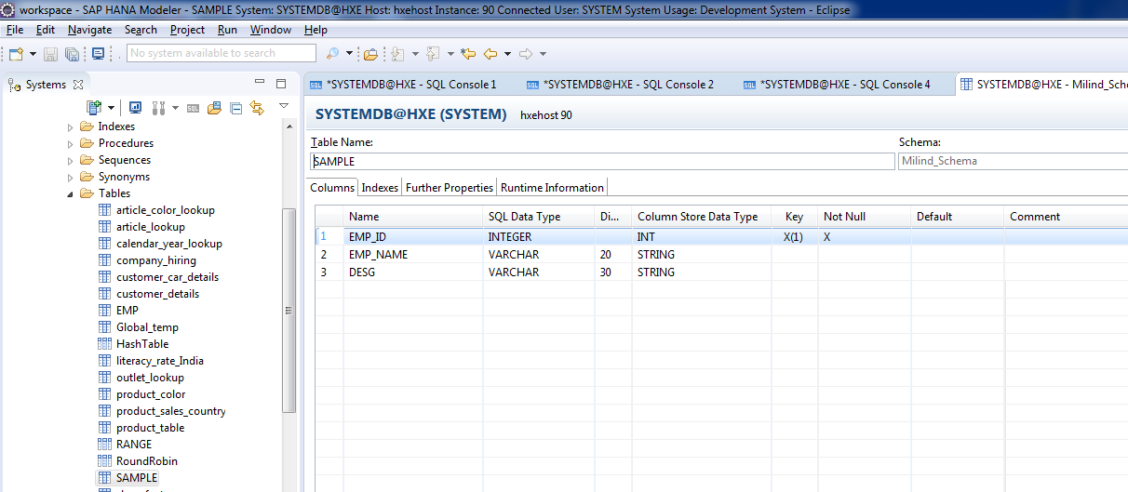
Cont.

Slide 11
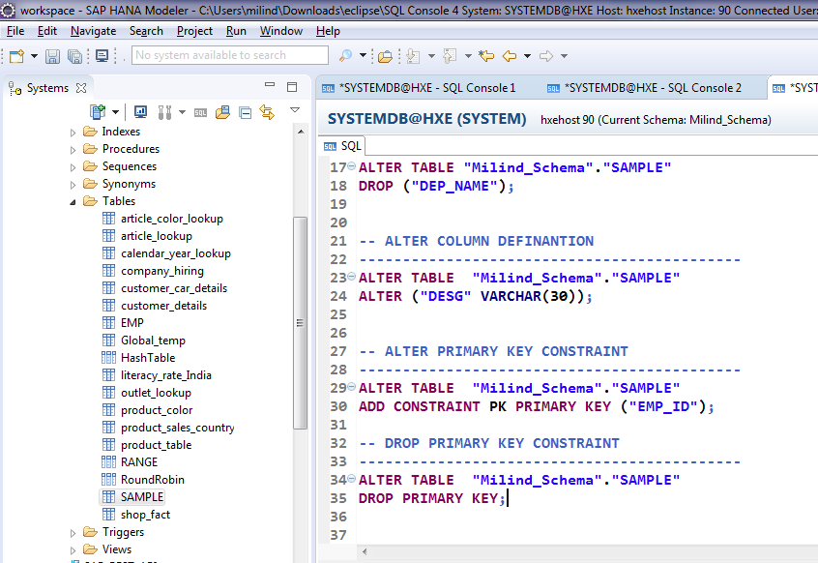
Drop PK key.

Slide 12
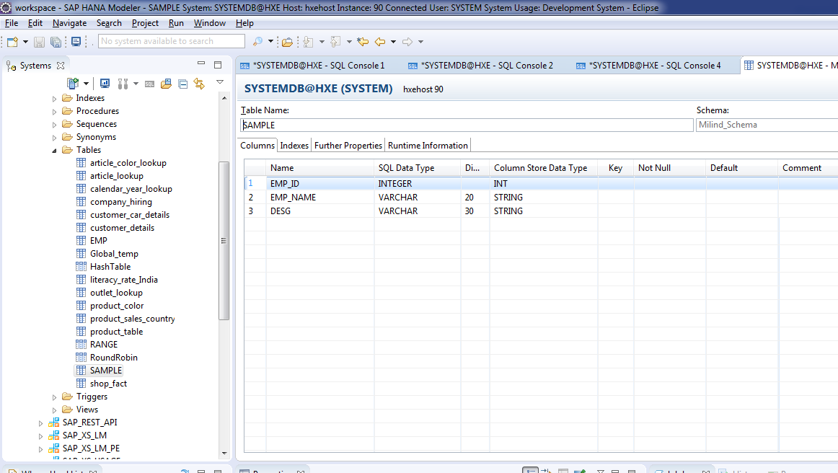
Cont.

